Slide 1
Engineering Mechanics
Lecture - 4

Slide 2
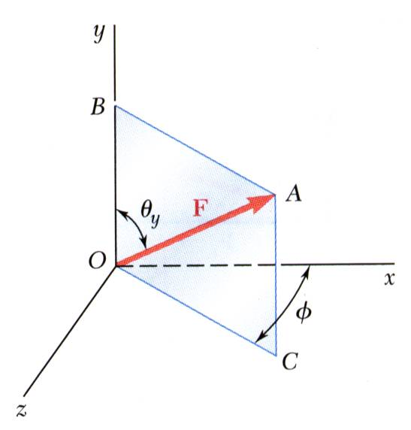
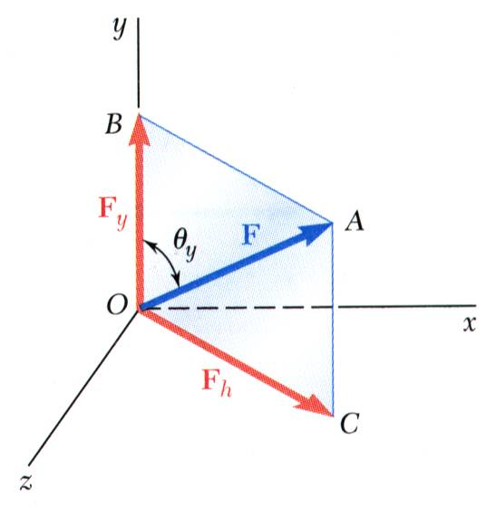
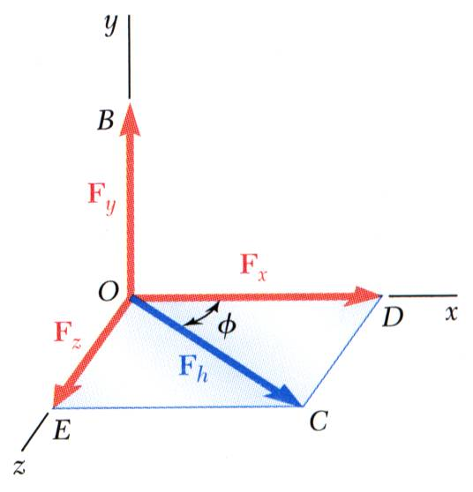
3-D Space

Slide 3
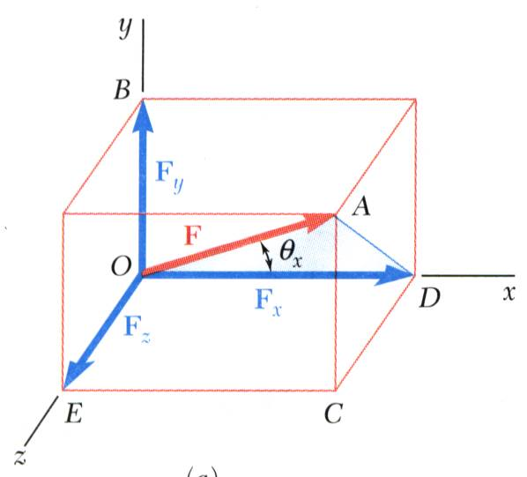
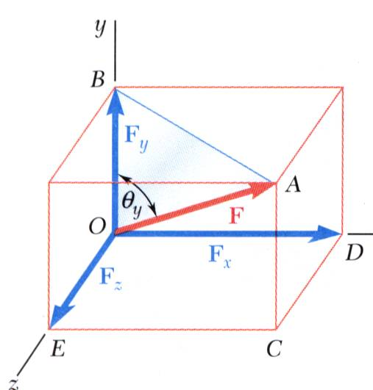
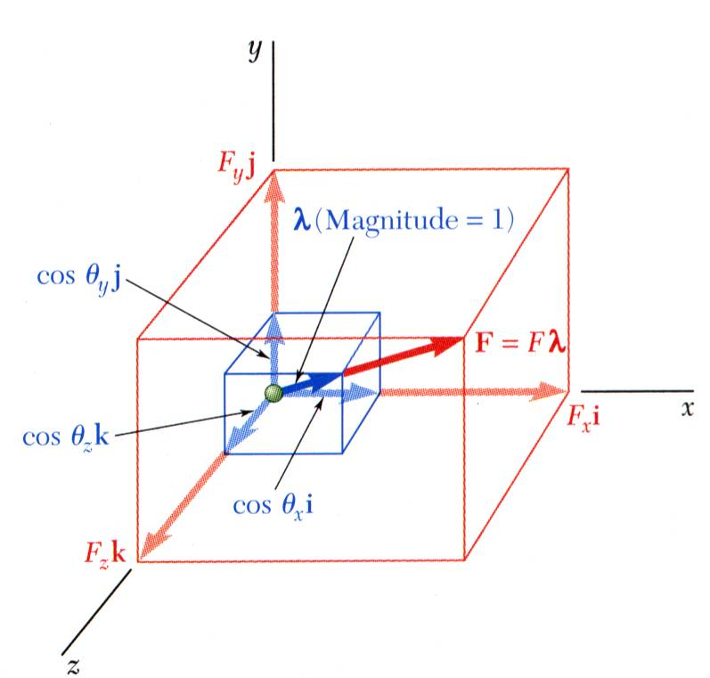
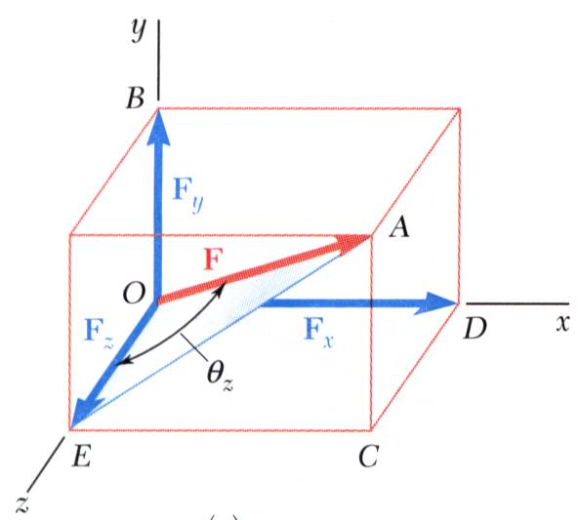
3-D Space

Slide 4
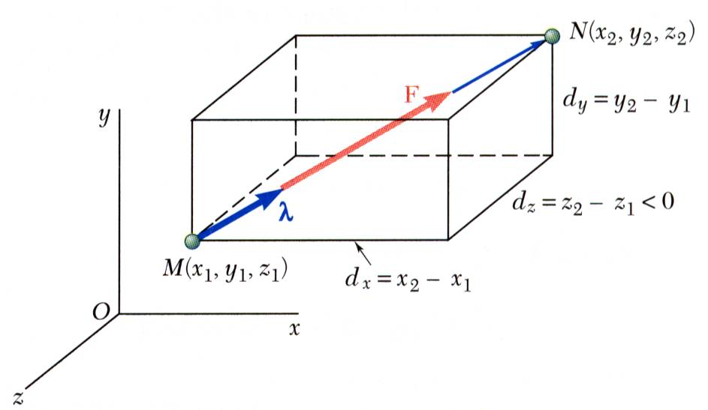
3-D Space

Slide 5
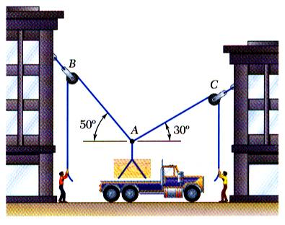





Free Body Diagram (FBD) vs. Space Diagram
$$T_{AB}$$
$$T_{AC}$$
$${50}^{0}$$
$${45}^{0}$$
$$W$$
Space Diagram: A sketch showing the physical conditions of the problem, usually provided with the problem statement, or represented by the actual physical situation.
Free Body Diagram: A sketch showing only the forces on the selected particle.

Slide 6
Free Body Diagram (FBD) vs. Space Diagram
A sketch is drawn by removing the supporting surface.
Indicate all the applied/active forces that set the body in motion. Ex. weight of the body or applied force etc.
Indicate the reactive forces, such as those caused by constrained or support that prevents motion.
All the dimensions and angles, reference axis are shown in the sketch.

Slide 7
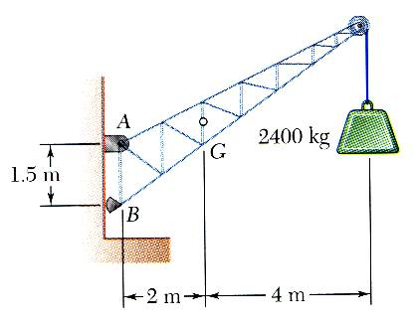
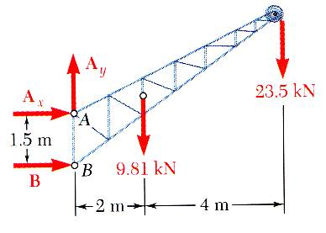
Free Body Diagram (FBD)
A FBD is a sketch of the selected system consisting of a body, a portion of a body or a collection of interconnected bodies completely isolated or free from other bodies showing the interconnection of all other bodies by forces on the one being considered.
Important: Essential characteristics of FBD
Sketch of the selected system.
System is isolated from other bodies including foundation and support.
The interaction on the system by each body remove in the isolation process is shown by forces in the diagram.
Known as well as unknown forces are to be indicated.
Generally unknown forces are constraint forces.
Indicate both magnitude and direction of external forces.
For unknown reaction forces assume any direction.
In calculation +ve means assumptions is ok else change it.
Include only essential dimensions only.

Slide 8
Free Body Diagram (FBD) vs. Space Diagram

Slide 9
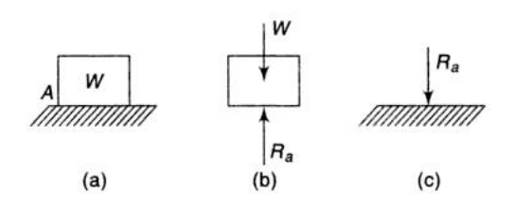
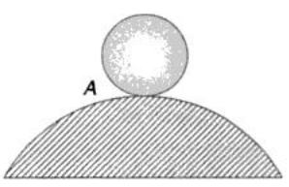
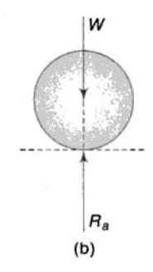
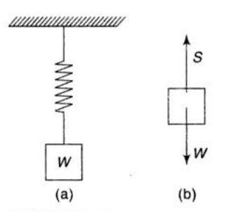
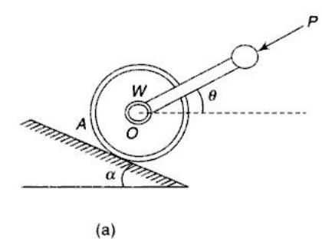
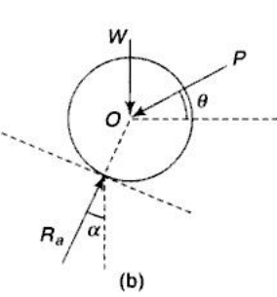
Free Body Diagram (FBD)

Slide 10
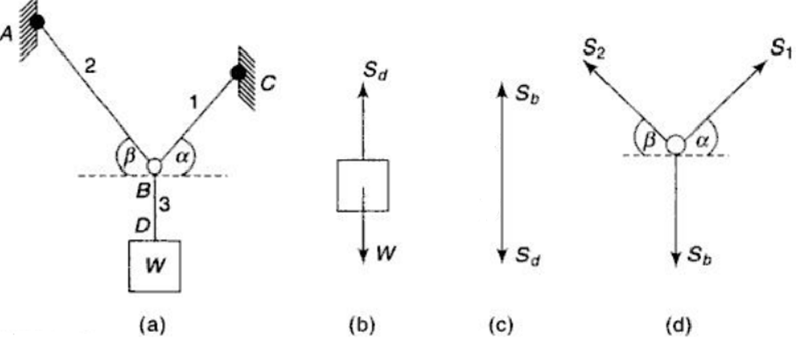
Free Body Diagram (FBD)

Slide 11
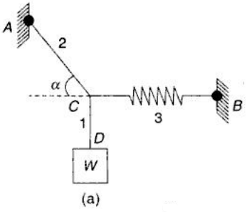
Free Body Diagram (FBD)

Slide 12
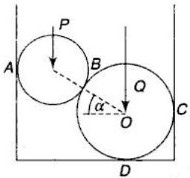
Free Body Diagram (FBD)

Slide 13
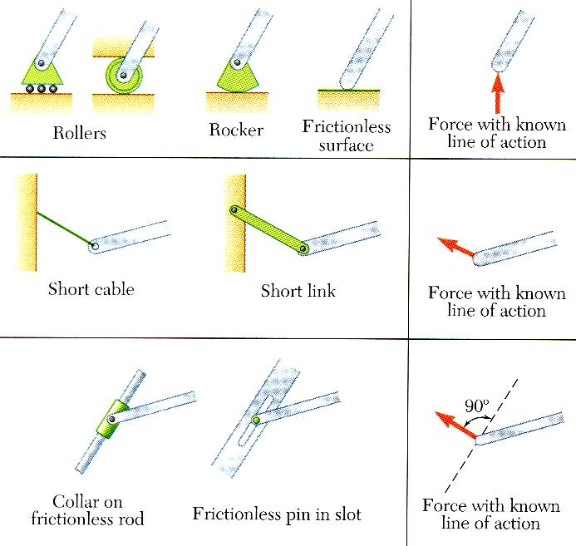
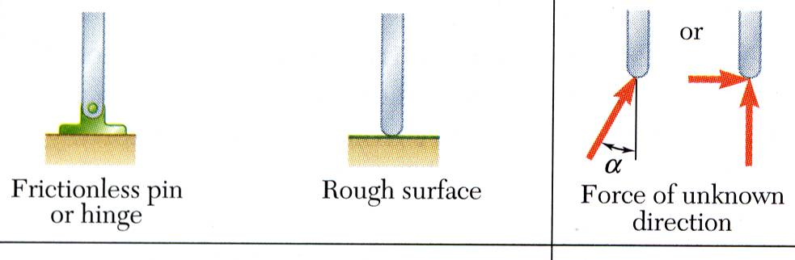
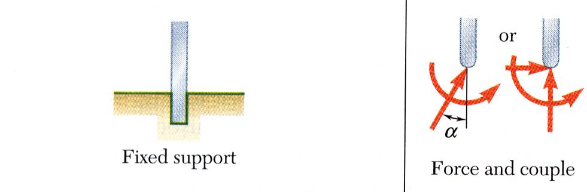
Free Body Diagram (FBD 2D structure)

Slide 14
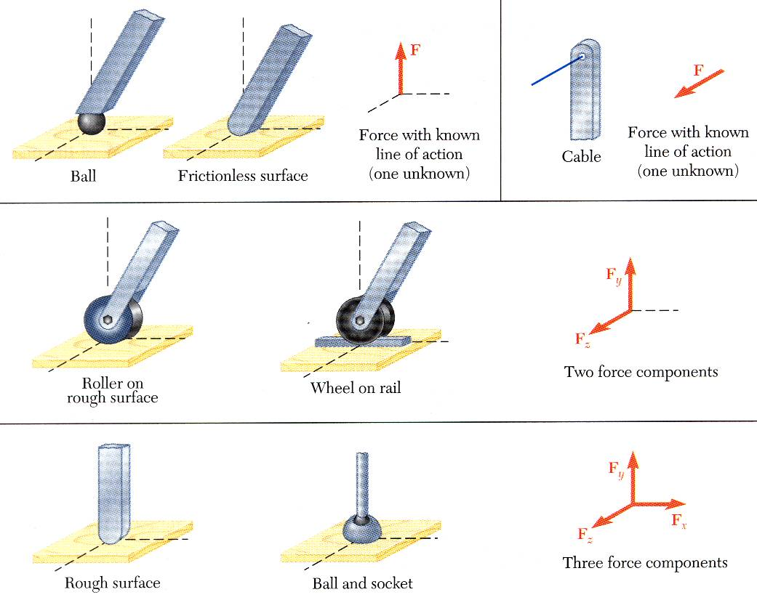
Free Body Diagram (FBD- 3D structure)

Slide 15
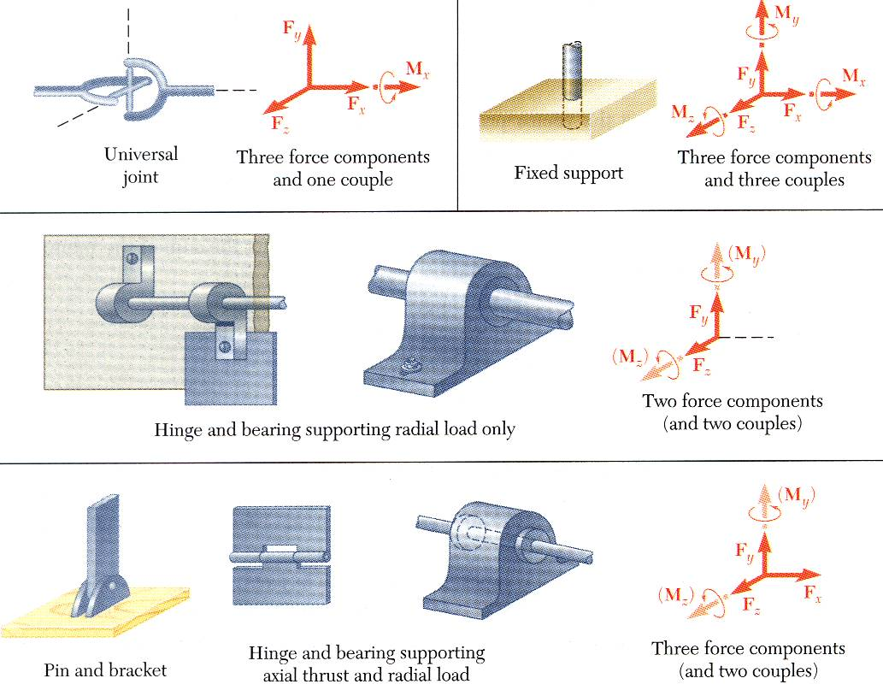
Free Body Diagram (FBD- 3D structure)

Slide 16
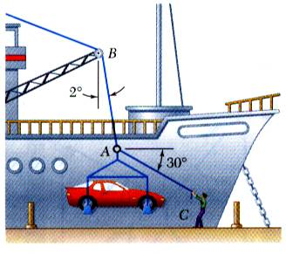
Free Body Diagram
In a ship-unloading operation, a 3500-lb automobile is supported by a cable. A rope is tied to the cable and pulled to center the automobile over its intended position. What is the tension in the rope?

Slide 17
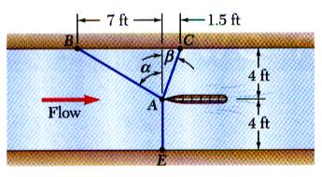
Free Body Diagram
It is desired to determine the drag force at a given speed on a prototype sailboat hull. A model is placed in a test channel and three cables are used to align its bow on the channel centerline. For a given speed, the tension is 40 lb in cable AB and 60 lb in cable AE.
Determine the drag force exerted on the hull and the tension in cable AC.

Slide 18
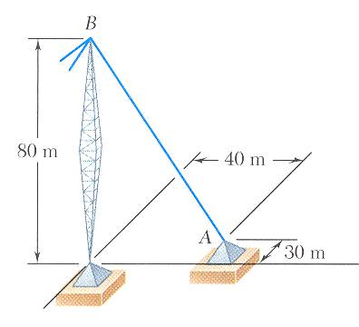
Free Body Diagram (FBD- 3D structure)
The tension in the guy wire is 2500 N. Determine:
a) components F_{x}, F_{y}, F_{z} of the force acting on the bolt at A,
b) the angles θ_{x}, θ_{y}, θ_{z} defining the direction of the force (the direction cosines)

Slide 19
Acknowledgement
NPTEL lectures on Engineering Mechanics
en.wikipedia.org/wiki/History_of_science
britannica.com/technology/history-of-flight
Beer & Johnston, Vector Mechanics for Engineers
Meriam & Kraige, Engineering Mechanics

Slide 20
Any Questions
⬧

